Slide 1
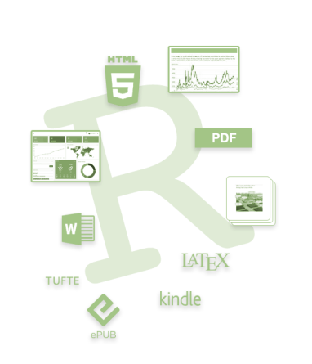

Git and R Markdown
Why they are useful and how to get started

Slide 2
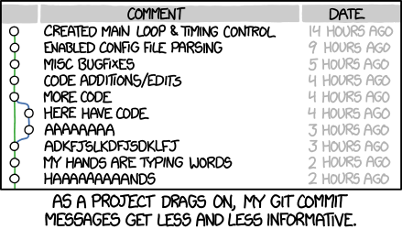

What is Git?
Distributed version control
Manages changes without overwriting them

Slide 3
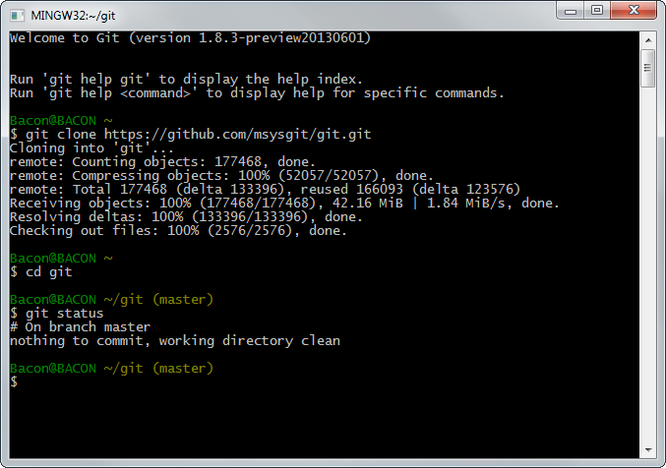
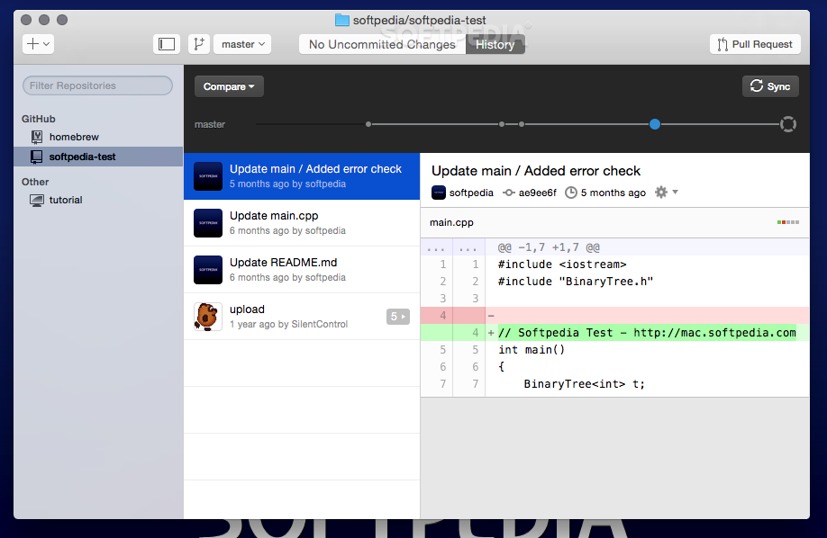
What is Git?
Distributed version control
Shell software and GUIs

Slide 4
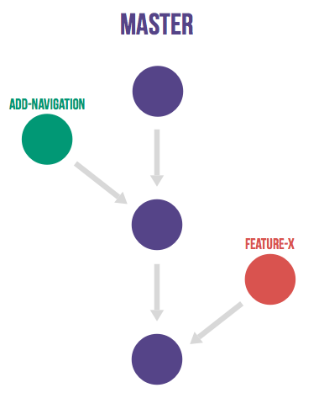
What is Git?
Distributed version control
Manages changes without overwriting them
Local and remote copies

Slide 5
What is Git?
Distributed version control
Manages changes without overwriting them
Local and remote copies
GitHub: Collaborative platform and hosting service

Slide 6
Why use Git?
Code sharing and publishing, a programmer’s Linked In?
Or: Word track changes + Dropbox shared folders
Not just for code: any type of file
Not just for coders: GUIs available
Manages and stores revisions: filing system for drafts
Joint projects
Public repositories are helpful e.g. ATAC-seq QC

Slide 7
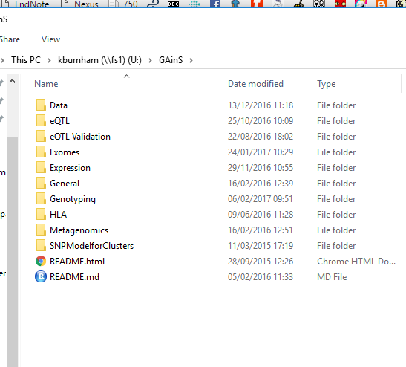
How do you use Git?
Usual folder structure on your computer

Slide 8
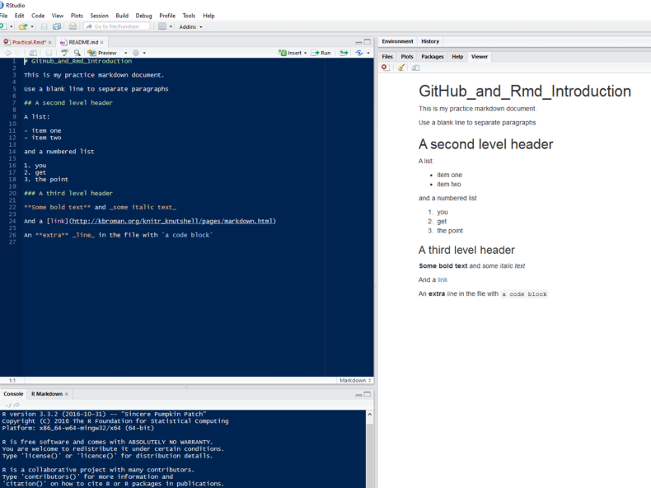
How do you use Git?
Usual folder structure on your computer
Do some work (the hardest part)

Slide 9
How do you use Git?
Usual folder structure on your computer
Do some work
Save your changes locally; Git notices and tracks them
Confirm that you want these changes to be remembered
Synchronise with a central copy of your folder on GitHub

Slide 10
How do you use Git?
Download from the central copy to another computer (this could be you, or someone else)
Do some work
Synchronise (push) the changes to GitHub
Pull them down to the first computer

Slide 11
Some terms you will come across
Repository - a directory
Remote - the online copy (also called the origin)
Clone - download a whole repository
Add - changes that you add are waiting (staged) to be stored
Commit - store a snapshot
Push - upload changes
Pull - download changes and merge all together
Notes:
A markup language is a system for annotating a document in a way that is syntactically distinguishable from the text.^{[1]} The idea and terminology evolved from the "marking up" of paper manuscripts, i.e., the revision instructions by editors, traditionally written with a blue pencil on authors' manuscripts.^{[citation needed]}
In digital media this "blue pencil instruction text" was replaced by tags, that is, instructions are expressed directly by tags or "instruction text encapsulated by tags." Examples include typesetting instructions such as those found in troff, TeX and LaTeX, or structural markers such as XML tags. Markup instructs the software that displays the text to carry out appropriate actions, but is omitted from the version of the text that users see.
Some markup languages, such as the widely used HTML, have pre-defined presentation semantics—meaning that their specification prescribes how to present the structured data. Others, such as XML, do not have them and are general purpose.

Slide 12
Some terms you might come across
Revert – reverse previous changes (but still store them)
Branch - a parallel copy of the repository
Master – the main/default branch
Fetch - download changes
Checkout – switch branches or discard changes
Merge - combine branches
Fork – duplicate a repository
Notes:
A markup language is a system for annotating a document in a way that is syntactically distinguishable from the text.^{[1]} The idea and terminology evolved from the "marking up" of paper manuscripts, i.e., the revision instructions by editors, traditionally written with a blue pencil on authors' manuscripts.^{[citation needed]}
In digital media this "blue pencil instruction text" was replaced by tags, that is, instructions are expressed directly by tags or "instruction text encapsulated by tags." Examples include typesetting instructions such as those found in troff, TeX and LaTeX, or structural markers such as XML tags. Markup instructs the software that displays the text to carry out appropriate actions, but is omitted from the version of the text that users see.
Some markup languages, such as the widely used HTML, have pre-defined presentation semantics—meaning that their specification prescribes how to present the structured data. Others, such as XML, do not have them and are general purpose.

Slide 13
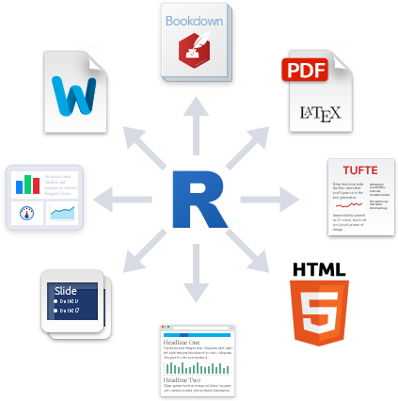
What is R Markdown?
Lightweight markup for interactive documents
Instruction tags e.g. HTML, LaTeX
Word: WYSIWYG
Readable markup + conversion tool
Include code (R, Python, SQL) in your text
Reproducible dynamic documents
Notes:
A markup language is a system for annotating a document in a way that is syntactically distinguishable from the text.^{[1]} The idea and terminology evolved from the "marking up" of paper manuscripts, i.e., the revision instructions by editors, traditionally written with a blue pencil on authors' manuscripts.^{[citation needed]}
In digital media this "blue pencil instruction text" was replaced by tags, that is, instructions are expressed directly by tags or "instruction text encapsulated by tags." Examples include typesetting instructions such as those found in troff, TeX and LaTeX, or structural markers such as XML tags. Markup instructs the software that displays the text to carry out appropriate actions, but is omitted from the version of the text that users see.
Some markup languages, such as the widely used HTML, have pre-defined presentation semantics—meaning that their specification prescribes how to present the structured data. Others, such as XML, do not have them and are general purpose.

Slide 14
Why use Markdown?
Word + figures = Yuck.
Generate nice HTML/PDFs/Word docs
Good integration with GitHub
REALLY useful for R(/python/bash/SQL) users: integrate code and generate summary docs all in one
Reproducible and dynamic analysis
(Parameters, slideshows, notebooks, websites…)

Slide 15
Why use Markdown?
<html>
<body>
<h1>Title</h1>
</head>
</html>
\documentclass[a4paper,12pt]{report}
\textheight=23.5cm
\textwidth=15cm
\section{Title}
# Title

Slide 16
How do you use R Markdown?
Open an R Markdown file in R Studio
Type as normal
Add code in chunks
Click “Knit” to generate the document
Open the file created in the same directory

